Slide 1

Frito lay: Predicting Attrition and salary
Lauren nelson & Jordan eaddy – Dds 6306 – case study 2

Slide 2
data and goals
Discover Any Job Role Specific Trends
Identify Factors that Lead to Attrition
Model to Predict Employee Turnover
Model to Predict Monthly Income

Slide 3
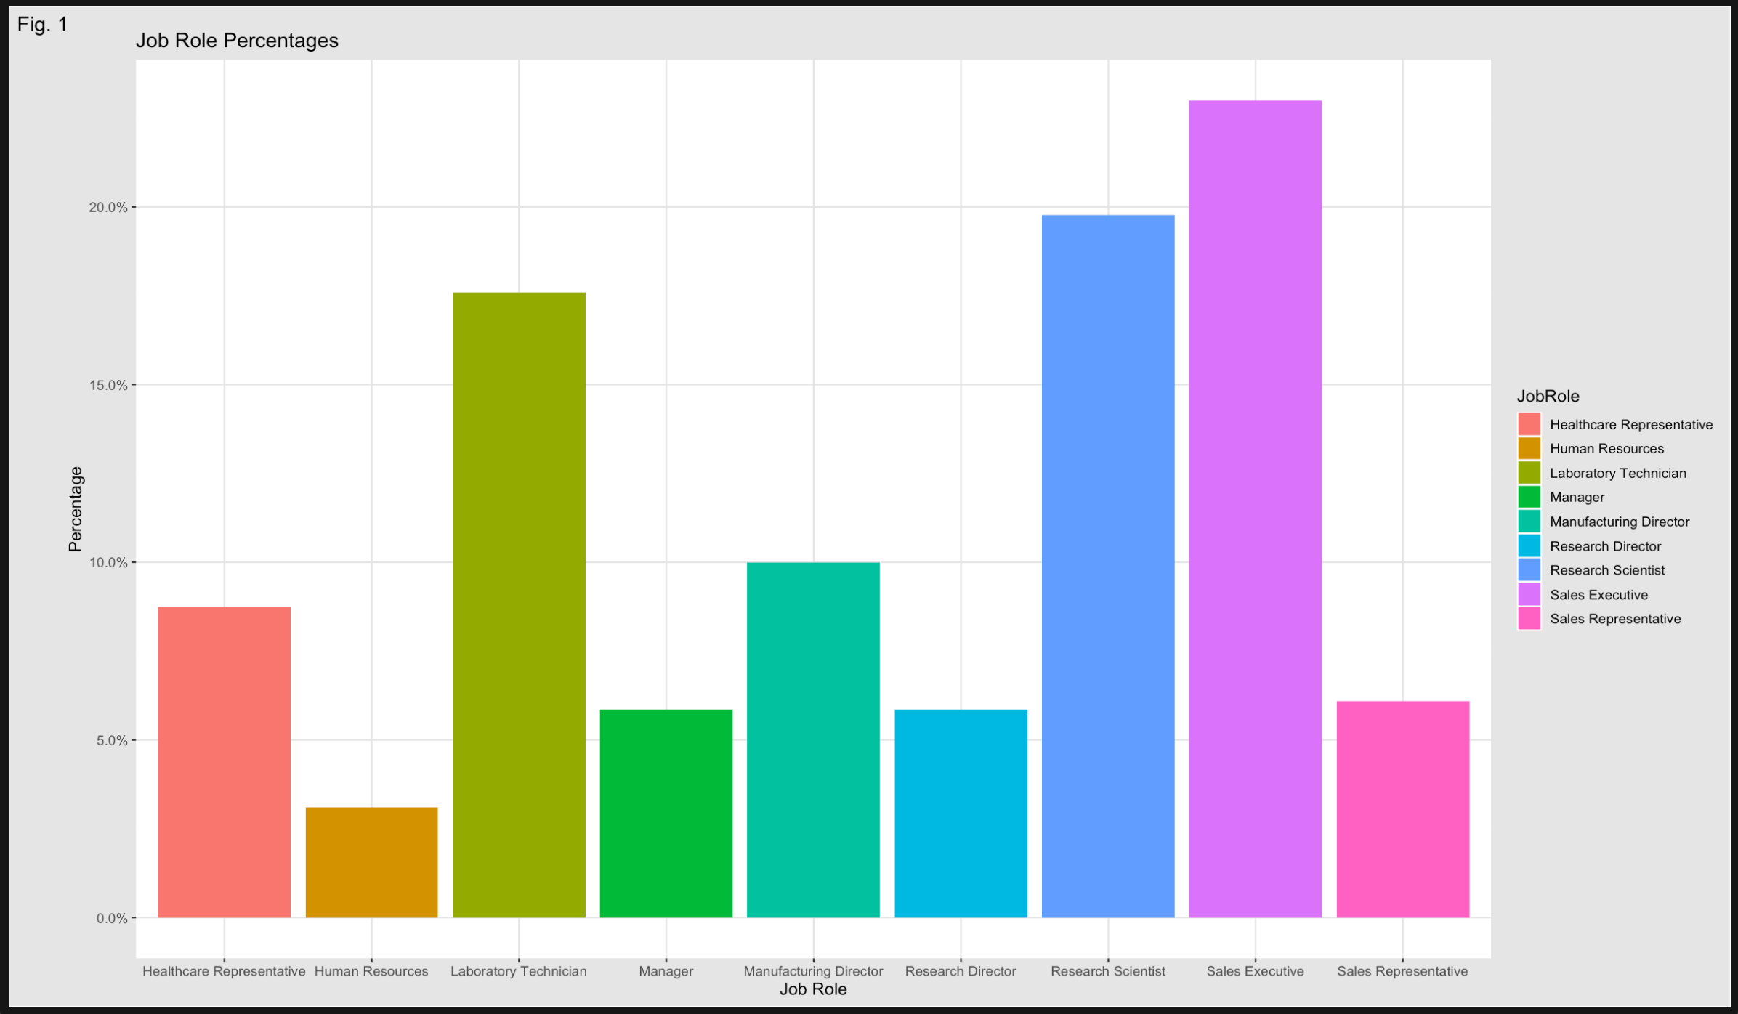
Job Role specific Trends

Slide 4
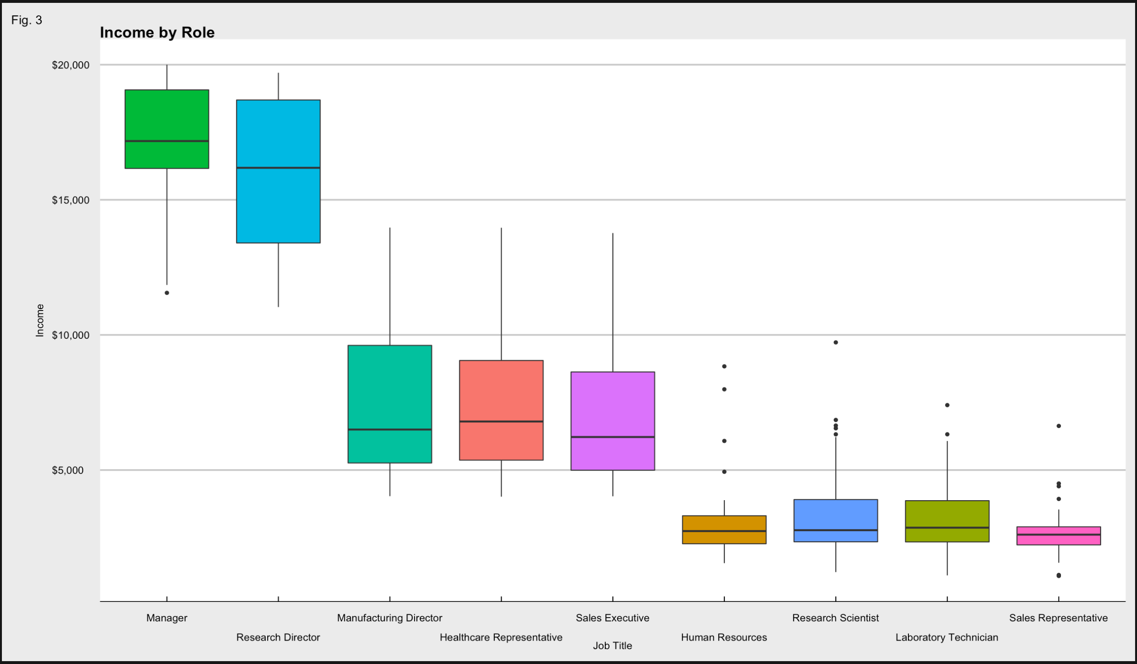
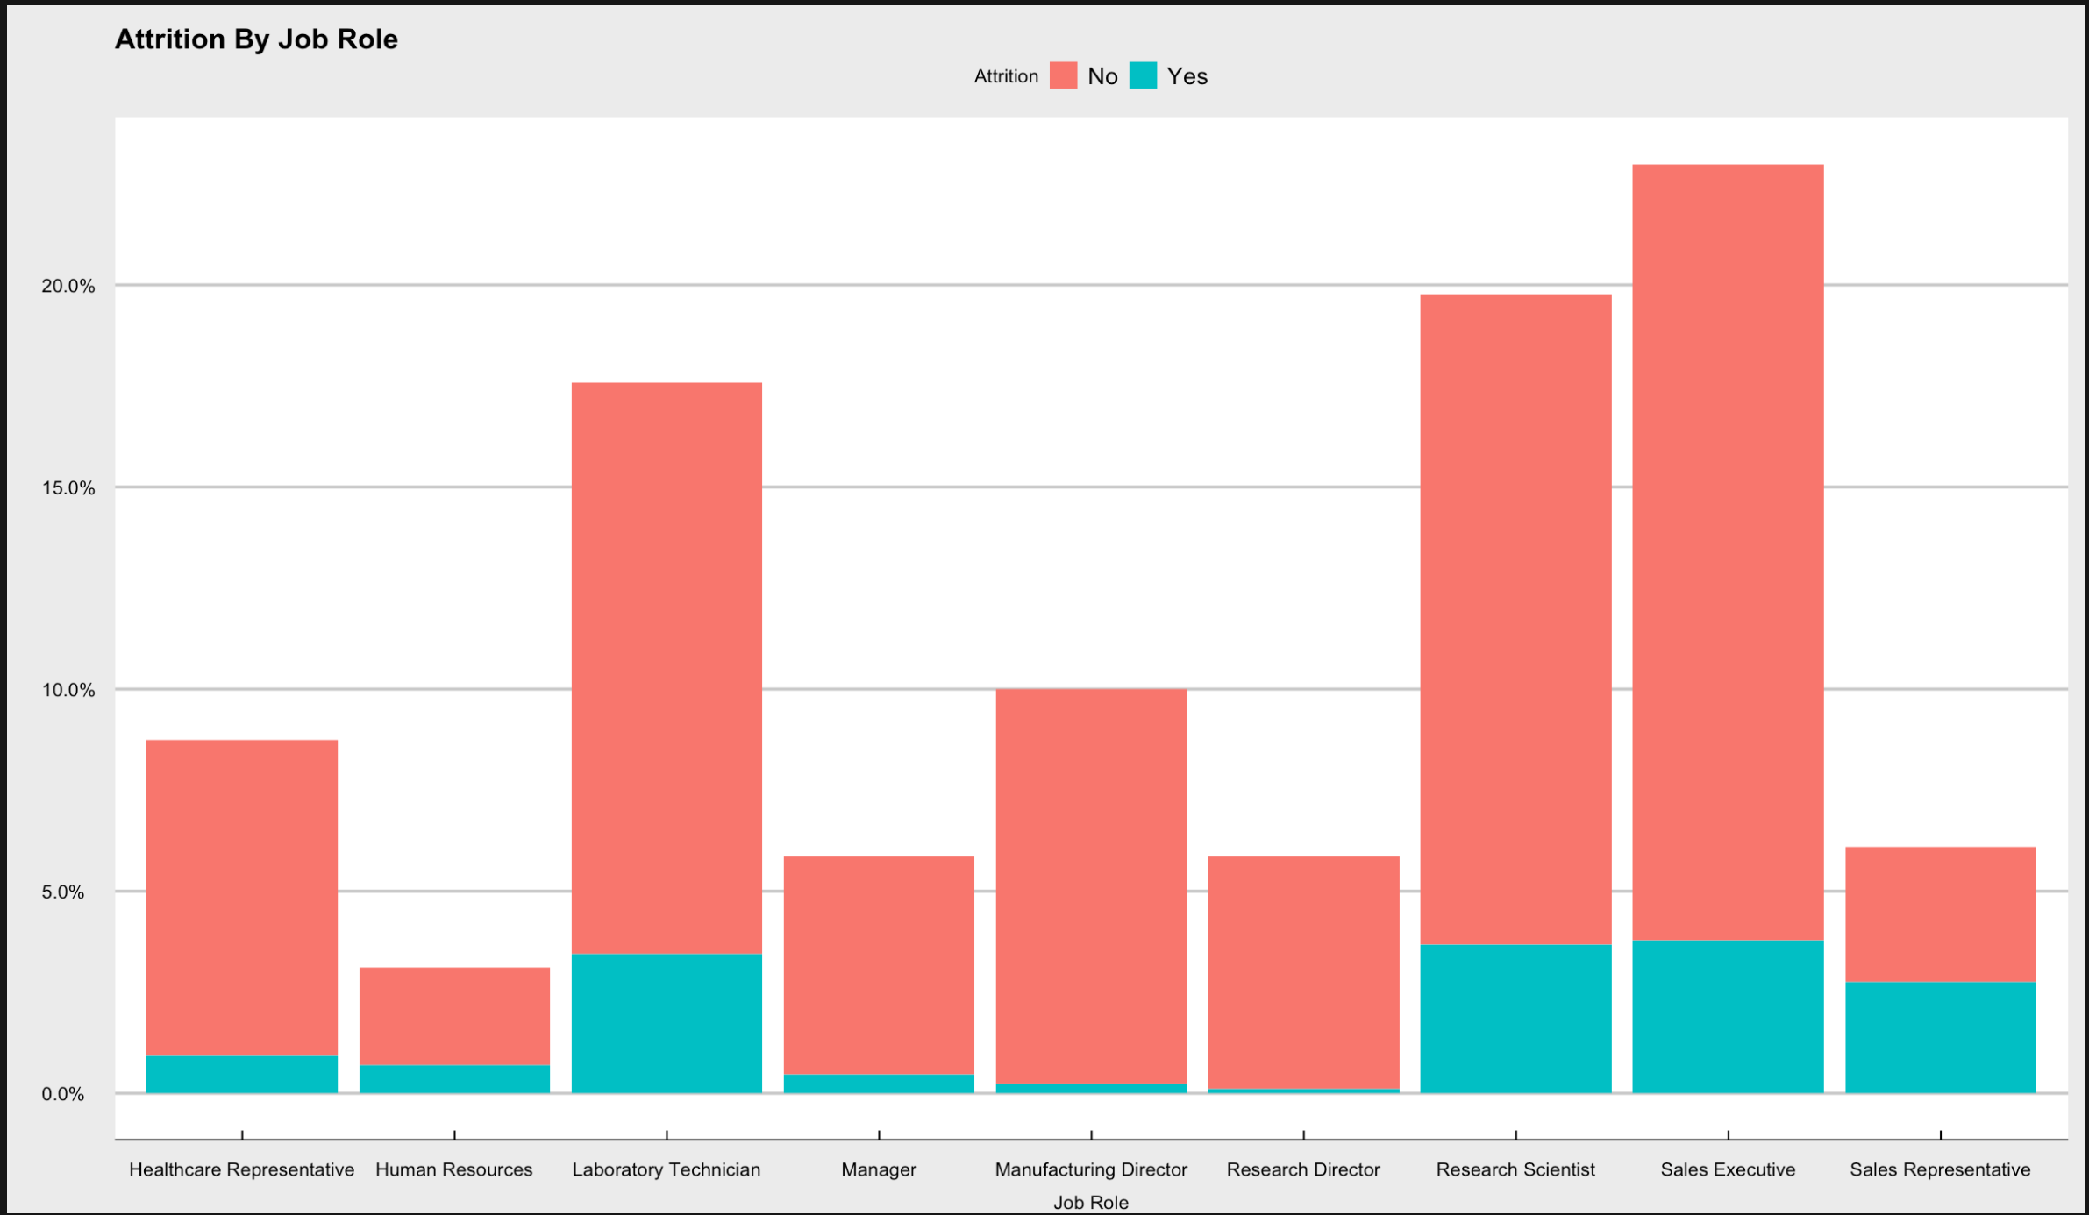
Sales Representatives have an attrition rate of nearly 50% !
Job Satisfaction is in the top 75th percentile...
The old saying…Money Talks…

Slide 5
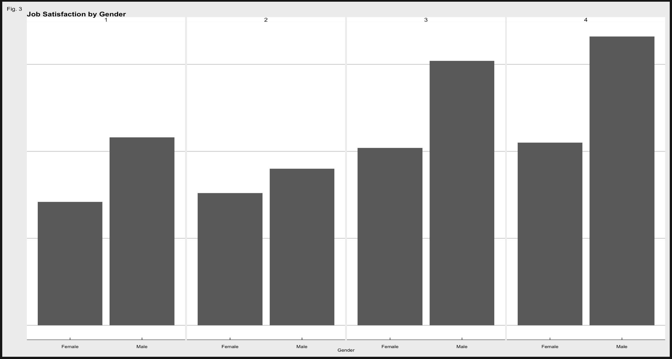
Gender inequality
Women seem to have the least Job Satisfaction

Slide 6
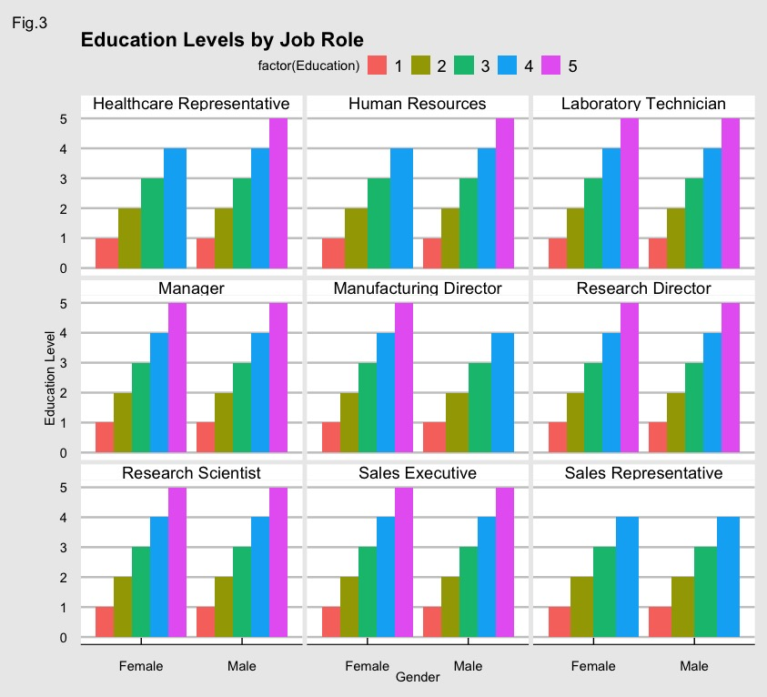
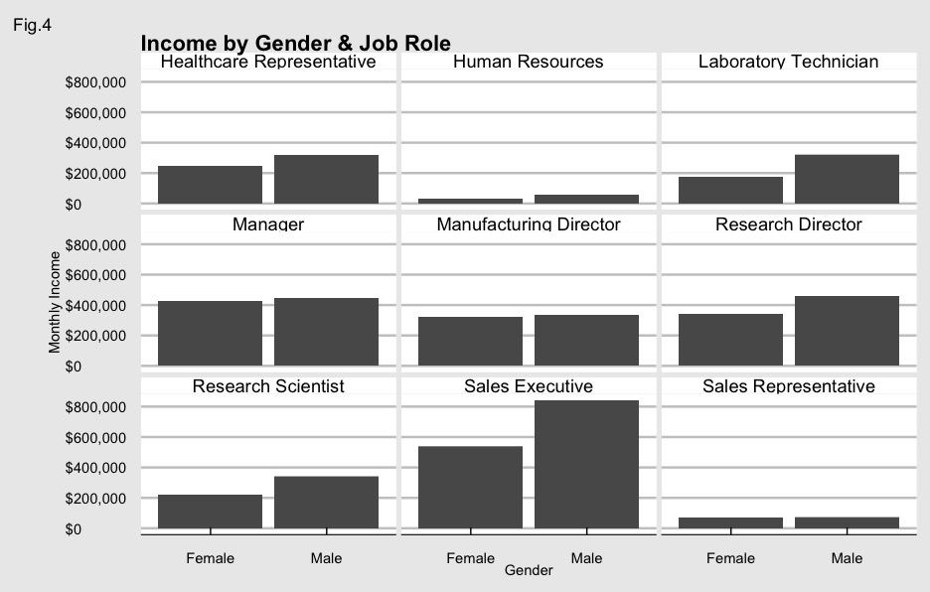
Education levels are fairly equal
But women are not paid accordingly

Slide 7
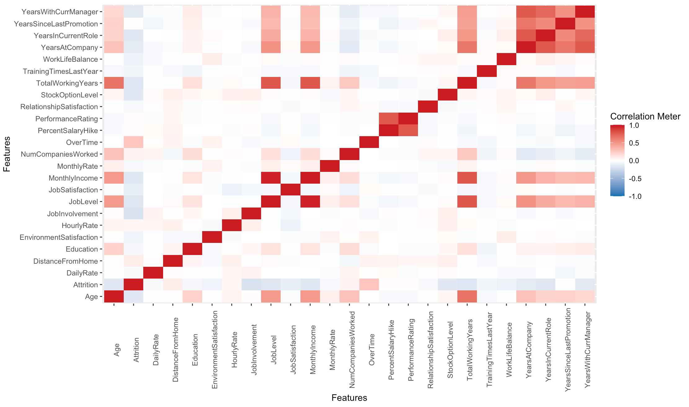
Continuous Variable Correlations
Notes:
According to this correlation matrix, the Highest Correlations with Attrition (specifically) are Overtime, Distance from Home (Commute), and Hourly Rate

Slide 8
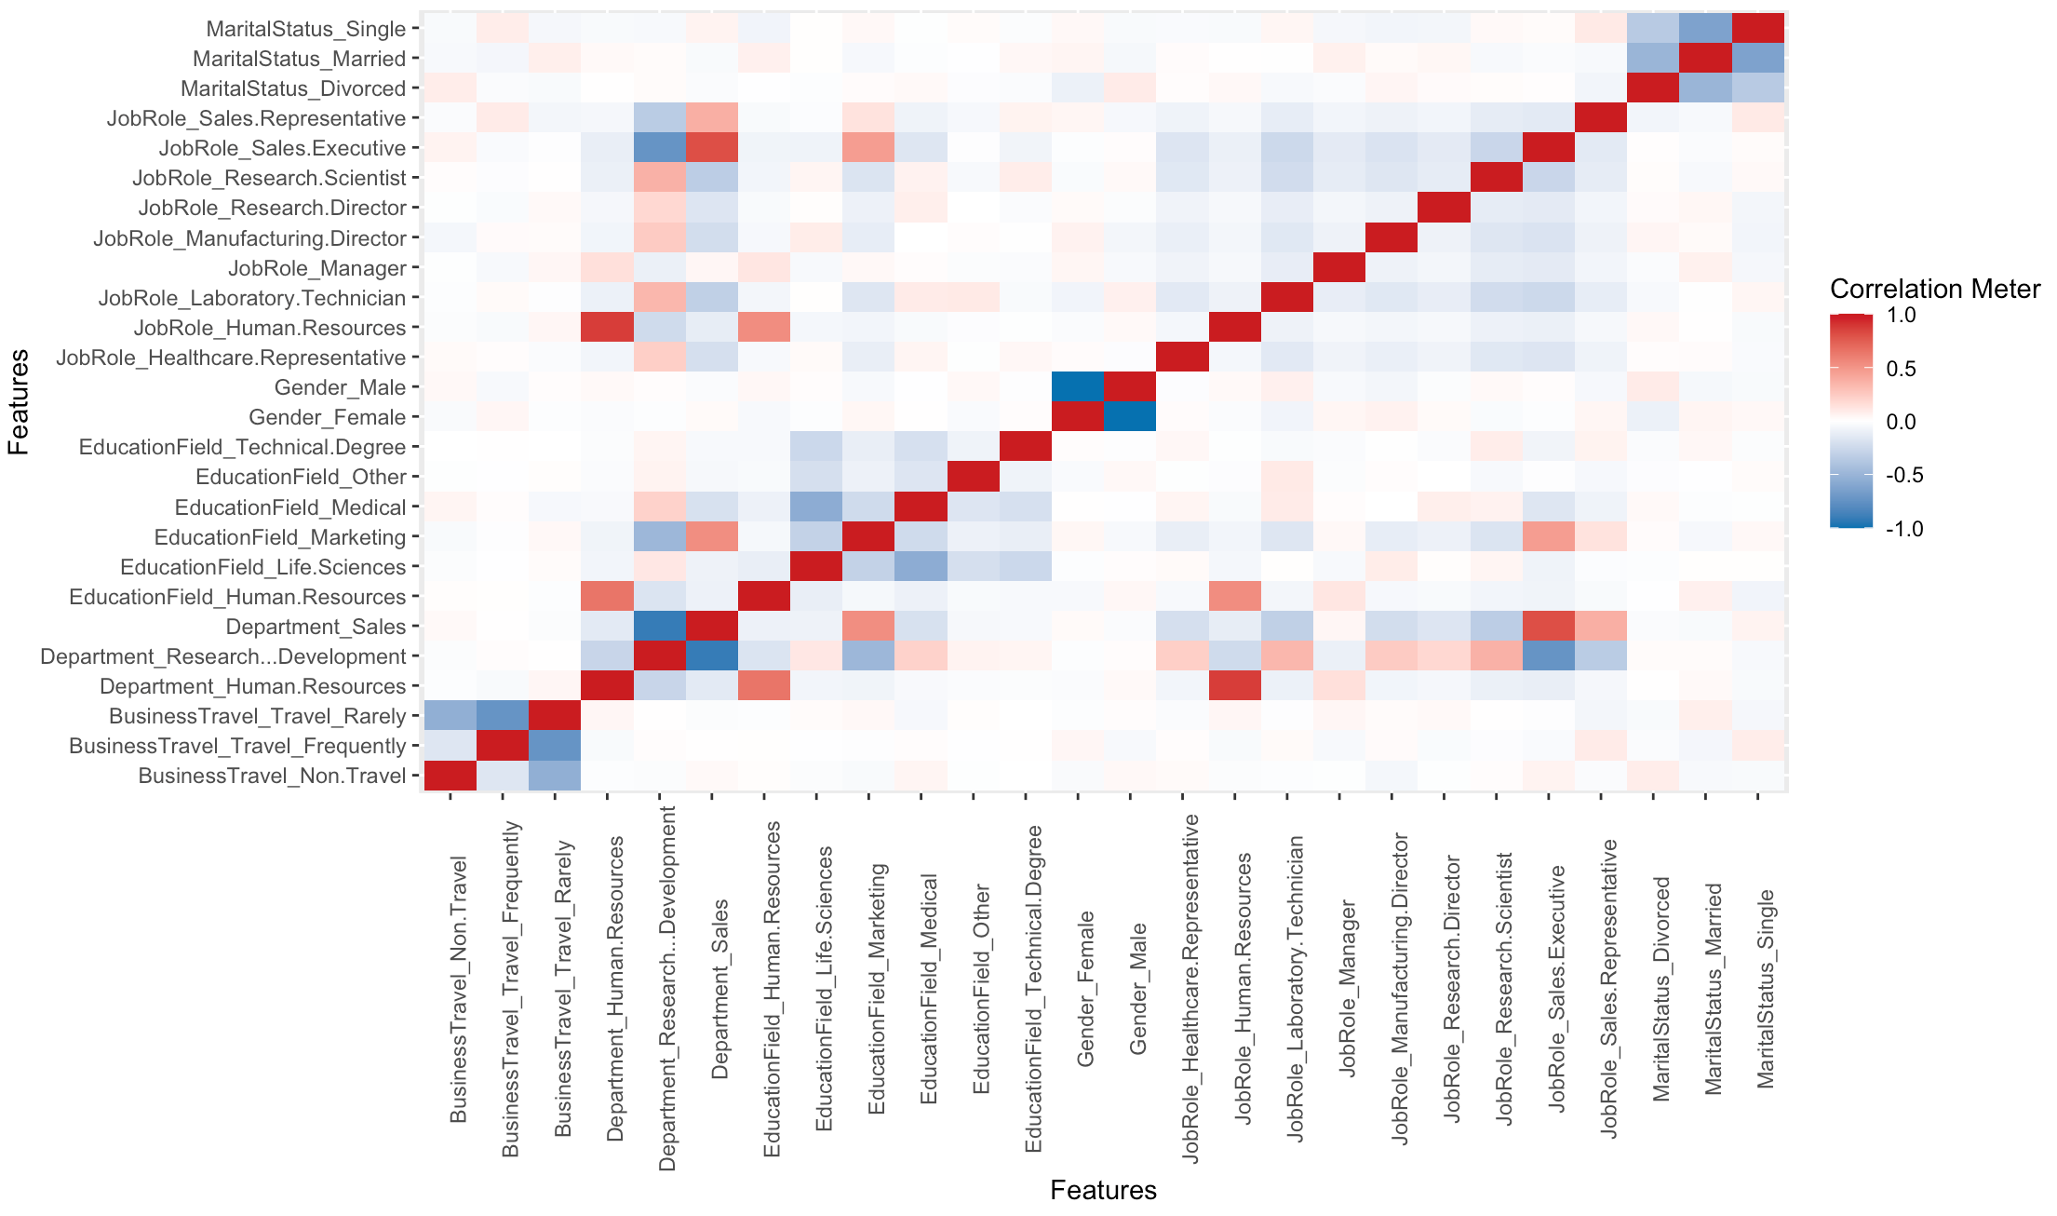
Discrete variable correlations
Notes:
Here we can see that there is a higher correlation between a single marital status and Frequent Business Travel, even a high correlation between single marital status and a job role of “Sales Representative.” There is also an indication that there is a higher divorce rate among the male population.

Slide 9
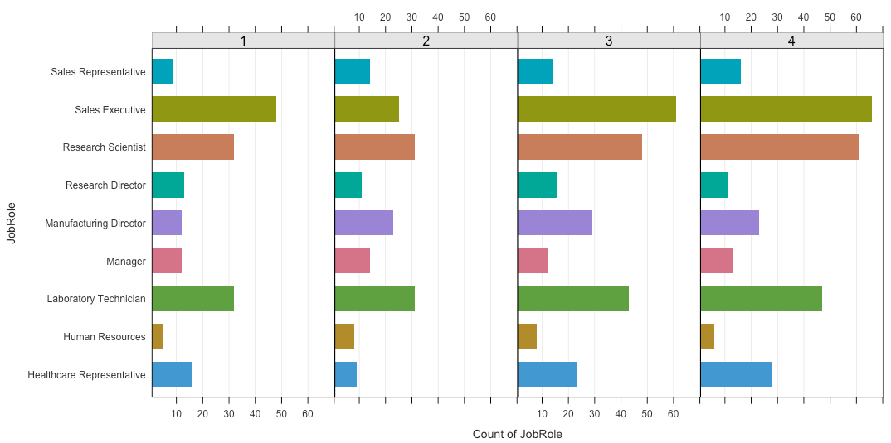
Job Satisfaction by Job Role
Notes:
Those with a job role of “Sales Executive” have the highest job satisfaction, followed by Research Scientist and then Laboratory Technician. Coincidentally, these same three job roles are among the job roles with the lowest satisfaction as well.

Slide 10
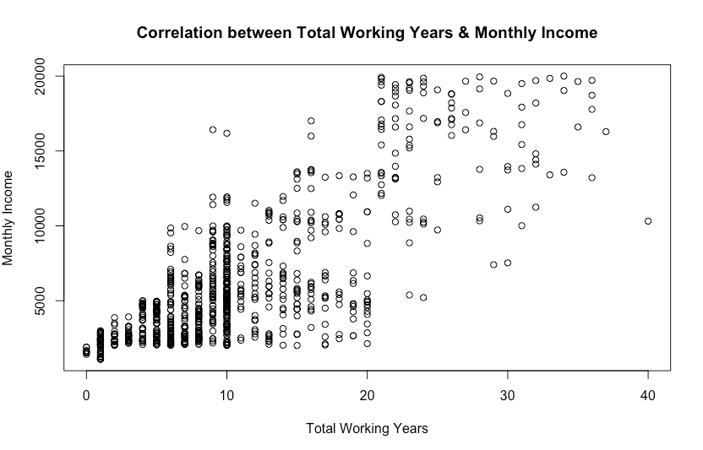
Notes:
Here we can see a positive correlation between the number of total working years and monthly income. As you can see, those with a total number of working years > 20 are among the population that has the highest income.

Slide 11
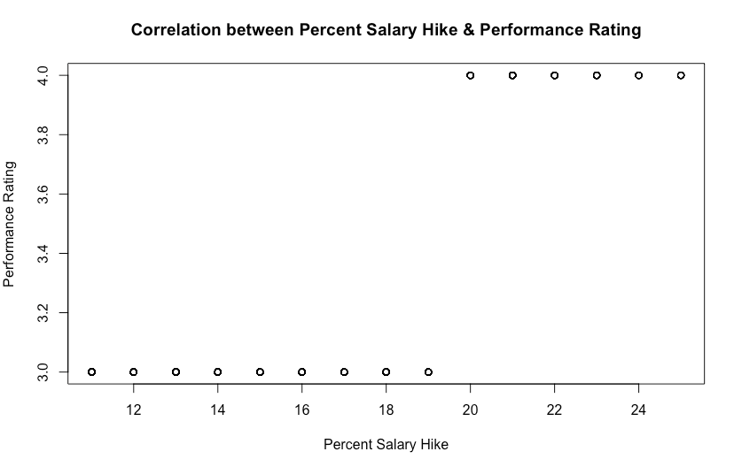
THE HIGHER THE PERFORMANCE RATING, THE HIGHER THE PERCENTAGE OF SALARY INCREASE
Notes:
Here we can see that the annual reviews that most employees would prefer to avoid, actually do pay off. The higher the performance rating, the higher the salary increase.

Slide 12
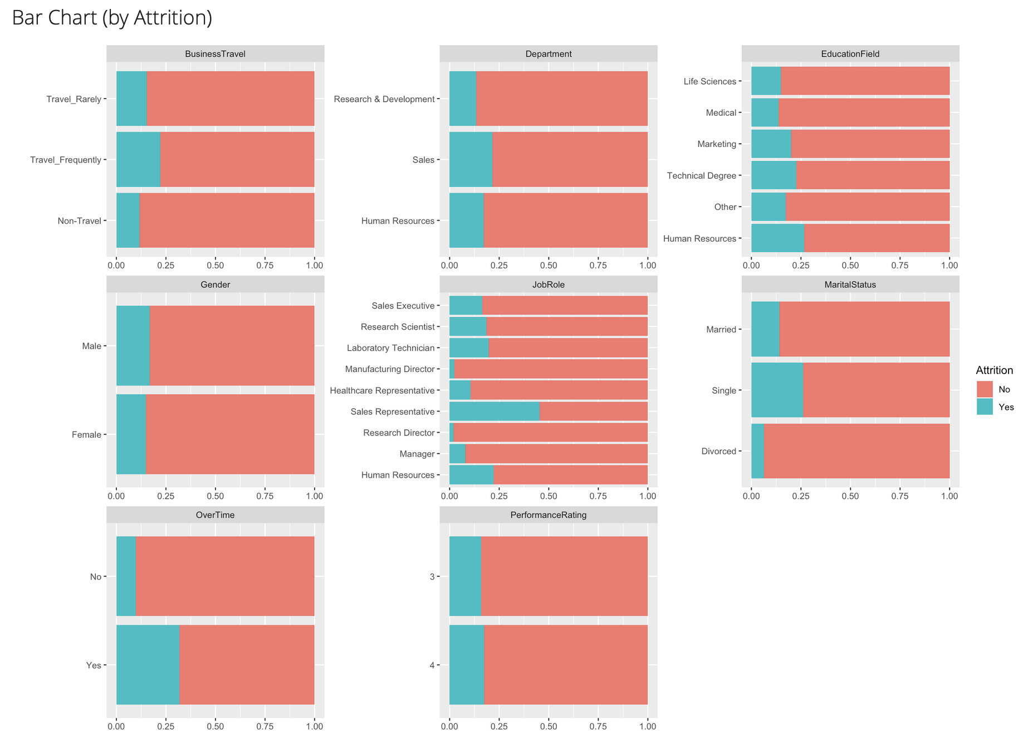
Overtime
Frequent Travel
Sales Representative
Single Marital Status
Notes:
Here we are looking at the highest Attrition correlations.

Slide 13
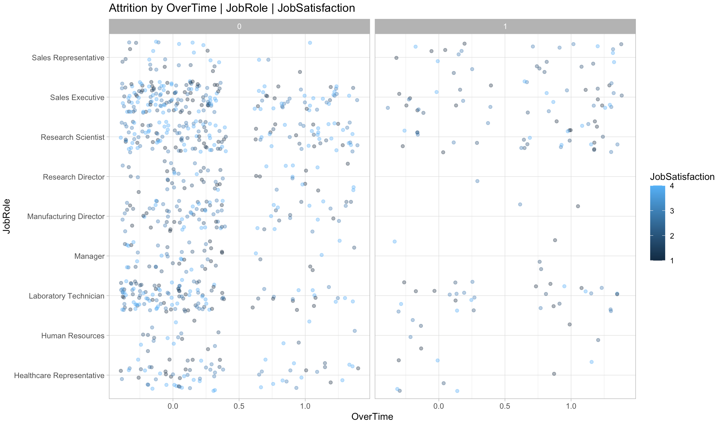

Slide 14
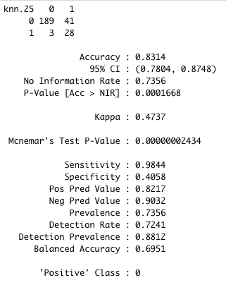
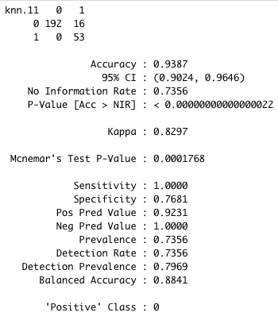
K-NEAREST NEIGHBOR MODELING TO PREDICT ATTRITION
K=25
Sensitivity = 98%
Specificity = 41%
Accuracy = 83%
K = 11
Sensitivity = 100%
Specificity = 77%
Accuracy = 94%
Notes:
With K Nearest Neighbor Modeling, we provide the dataset to then model predicted outcomes among a test set of data. The value for K was calculated using the square root of the number of observations within the training set, which was a value of 609. Therefore, our initial K value was 25. With K=25 we had a sensitivity of 98%, Specificity of 41 % and Accuracy of 83%.
However when evaluating the best measure for K, K=11 provided a sensitivity of 100%, Specificity of 77% and an Accuracy of 94%.

Slide 15
Variables that attribute to monthly income
Strong Correlation | Average Correlation | Weak Correlation
Job Level ~95% | Job Role & Total Working Years ~77% | Age ~50%

Slide 16
Linear Model with a rmse < $3000
~ $935
Job Level
Total Working Years
Monthly Income
Age
Job Role

Slide 17

Thank you for your time
Questions?
Lauren Nelson & Jordan Eaddy

